Slide 1
Texture Mapping

Slide 2
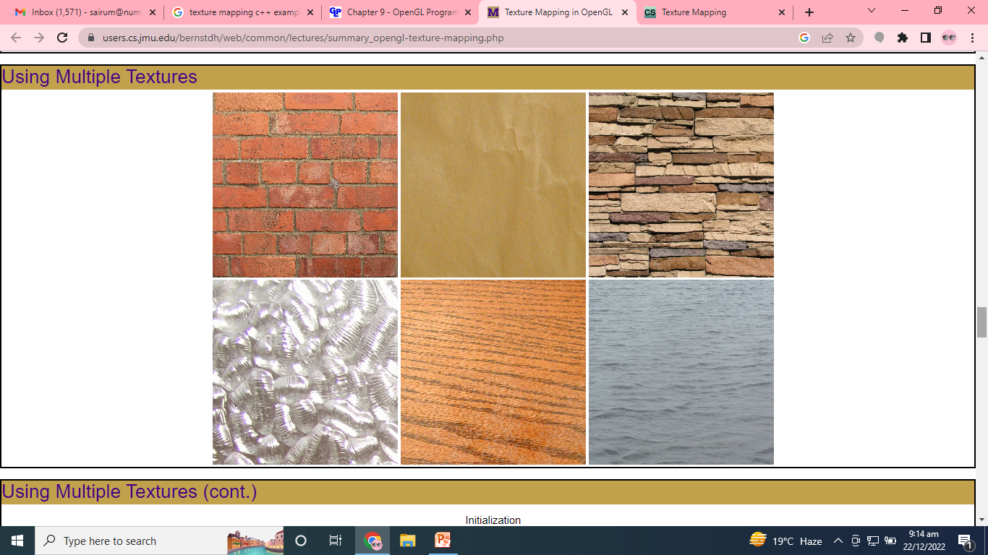

Slide 3
Texture mapping
Texture mapping is a graphic design process in which a two-dimensional (2-D) surface, called a texture map, is "wrapped around" a three-dimensional (3-D)object.
Thus, the 3-D object acquires a surface texture similar to that of the 2-D surface.
Texture mapping is the electronic equivalent of applying wallpaper, or paint to a real object.

Slide 4
Steps in Texture Mapping
Name the texture
Bind the texture to its name
Specify the parameters to use
Specify an application mode (either replace or modify)
Create the texture object
Enable texture mapping

Slide 5
Steps in the Rendering Process
Select a texture
Specify a mapping from the texture to pixels

Slide 6
Naming a Texture
The Function:
void glGenTextures(GLsizei n, GLuint* names)
Purpose:
Returns n unused "names" (actually integers)
The "names" need not be contiguous

Slide 7
Naming a Texture
static GLuint textureName;
// Get a name for the texture
glGenTextures(1, &textureName);

Slide 8
Binding a Texture to a Name
The Function:
void glBindTexture(GLenum target, GLuint name)
The Target:
Either GL_TEXTURE_1D, GL_TEXTURE_2D, GL_TEXTURE_3D or GL_TEXTURE_CUBE_MAP

Slide 9
Binding a Texture to a Name
// Bind the texture object to its name glBindTexture(GL_TEXTURE_2D, textureName);

Slide 10
Enable Texture Mapping
You need to enable texturing before drawing your scene.
Texturing is enabled or disabled using
glEnable() or glDisable()
with the symbolic constant GL_TEXTURE_1D or GL_TEXTURE_2D for one− or two−dimensional texturing, respectively.
(If both are enabled, GL_TEXTURE_2D is the one that is used.)

Slide 11
Example
#include <GL/gl.h>
#include <GL/glu.h>
#include <GL/glut.h>
#include <stdlib.h>
#include <stdio.h>
/* Create checkerboard texture */
#define checkImageWidth 64

Slide 12
#define checkImageHeight 64
static GLubyte checkImage[checkImageHeight][checkImageWidth][4];
static GLuint texName;
void makeCheckImage(void)
{ int i, j, c;
for (i = 0; i < checkImageHeight; i++) {
for (j = 0; j < checkImageWidth; j++) {
c = ((((i&0x8)==0)^((j&0x8))==0))*255;
checkImage[i][j][0] = (GLubyte) c;
checkImage[i][j][1] = (GLubyte) c;
checkImage[i][j][2] = (GLubyte) c;
checkImage[i][j][3] = (GLubyte) 255;
} }}

Slide 13
void init(void)
{ glClearColor (0.0, 0.0, 0.0, 0.0);
glShadeModel(GL_FLAT);
glEnable(GL_DEPTH_TEST);
makeCheckImage();
glPixelStorei(GL_UNPACK_ALIGNMENT, 1);
glGenTextures(1, &texName);
glBindTexture(GL_TEXTURE_2D, texName);
glTexParameteri(GL_TEXTURE_2D, GL_TEXTURE_WRAP_S, GL_REPEAT);
glTexParameteri(GL_TEXTURE_2D, GL_TEXTURE_WRAP_T, GL_REPEAT);
glTexParameteri(GL_TEXTURE_2D, GL_TEXTURE_MAG_FILTER, GL_NEAREST);
glTexParameteri(GL_TEXTURE_2D, GL_TEXTURE_MIN_FILTER, GL_NEAREST);
glTexImage2D(GL_TEXTURE_2D, 0, GL_RGBA, checkImageWidth,
checkImageHeight, 0, GL_RGBA, GL_UNSIGNED_BYTE, checkImage);
}

Slide 14
void display(void)
{ glClear(GL_COLOR_BUFFER_BIT | GL_DEPTH_BUFFER_BIT);
glEnable(GL_TEXTURE_2D);
glTexEnvf(GL_TEXTURE_ENV, GL_TEXTURE_ENV_MODE, GL_DECAL);
glBindTexture(GL_TEXTURE_2D, texName);
glBegin(GL_QUADS);
glTexCoord2f(0.0, 0.0); glVertex3f(−2.0, −1.0, 0.0);
glTexCoord2f(0.0, 1.0); glVertex3f(−2.0, 1.0, 0.0);
glTexCoord2f(1.0, 1.0); glVertex3f(0.0, 1.0, 0.0);
glTexCoord2f(1.0, 0.0); glVertex3f(0.0, −1.0, 0.0);
glTexCoord2f(0.0, 0.0); glVertex3f(1.0, −1.0, 0.0);
glTexCoord2f(0.0, 1.0); glVertex3f(1.0, 1.0, 0.0);
glTexCoord2f(1.0, 1.0); glVertex3f(2.41421, 1.0, −1.41421);
glTexCoord2f(1.0, 0.0); glVertex3f(2.41421, −1.0, −1.41421);
glEnd();
glFlush();
glDisable(GL_TEXTURE_2D);
}

Slide 15
void reshape(int w, int h)
{
glViewport(0, 0, (GLsizei) w, (GLsizei) h);
glMatrixMode(GL_PROJECTION);
glLoadIdentity();
gluPerspective(60.0, (GLfloat) w/(GLfloat) h, 1.0, 30.0);
glMatrixMode(GL_MODELVIEW);
glLoadIdentity();
glTranslatef(0.0, 0.0, −3.6);
}

Slide 16
void keyboard (unsigned char key, int x, int y)
{ switch (key) {
case 27:
exit(0);
break;
default:
break;
}}
int main(int argc, char** argv)
{ glutInit(&argc, argv);
glutInitDisplayMode(GLUT_SINGLE | GLUT_RGB | GLUT_DEPTH);
glutInitWindowSize(250, 250);
glutInitWindowPosition(100, 100);
glutCreateWindow(argv[0]);
init();
glutDisplayFunc(display);
glutReshapeFunc(reshape);
glutKeyboardFunc(keyboard);
glutMainLoop();
return 0;
}

Slide 17
Another Example
void display() {
// Clear the screen
glClear(GL_COLOR_BUFFER_BIT | GL_DEPTH_BUFFER_BIT);
// Select the texture object
glBindTexture(GL_TEXTURE_2D, textureName);
// Create the teapot
glutSolidTeapot(1.0);
// Force the rendering (off-screen)
glFlush();
// Handle the double buffering
glutSwapBuffers();
}

